Slide 1
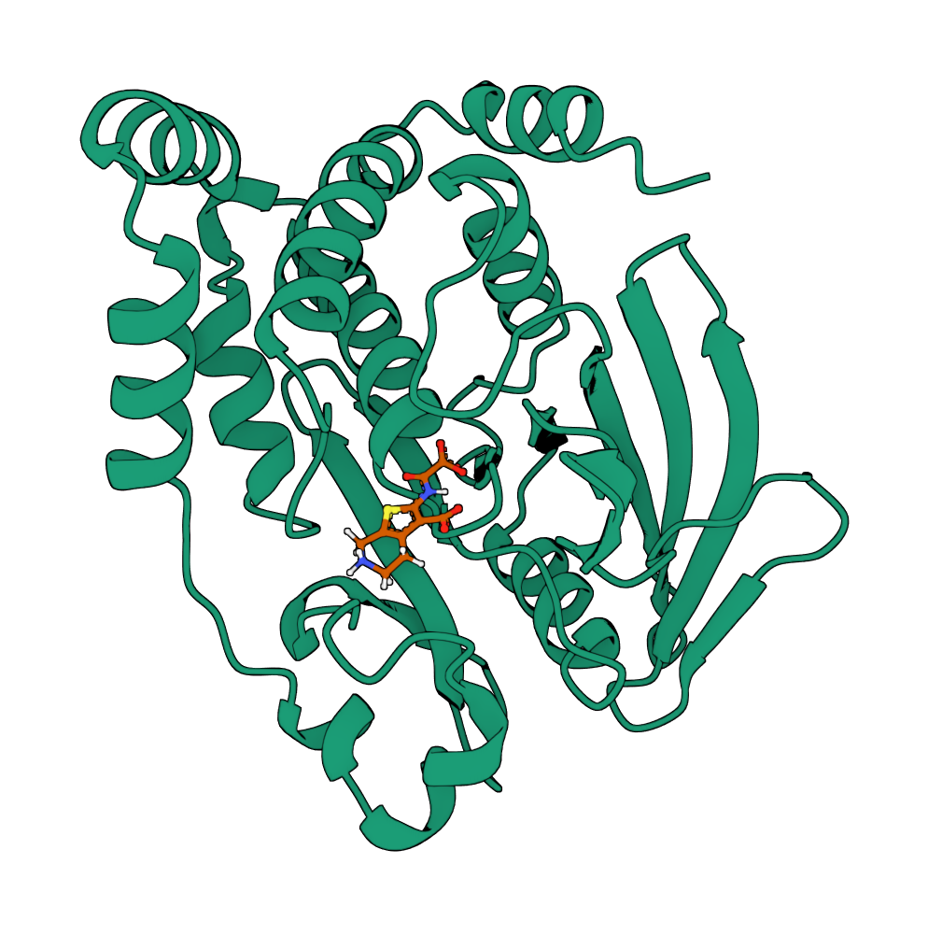
Dissertation Defense
Geometric Deep Learning &​
Generative Modeling of 3D Biomolecules
Alex Morehead, PhD Candidate
University of Missouri, April 28th, 2025

Slide 2
Presentation Overview
Geometric Deep Learning (e.g., AlphaFold 2, Geometric Transformer, GCPNet)
Generative Models
(e.g., AlphaFold 3, GCDM,
FlowDock)
Biomolecule Design
(e.g., RFdiffusionAA,
GCDM-SBDD, PoseBench)
In this defense, we discuss three synergistic research areas that have recently experienced huge growth

Slide 3
What is Geometric Deep Learning?
Reference: Bronstein et al. 2025, MIT Press

Slide 4
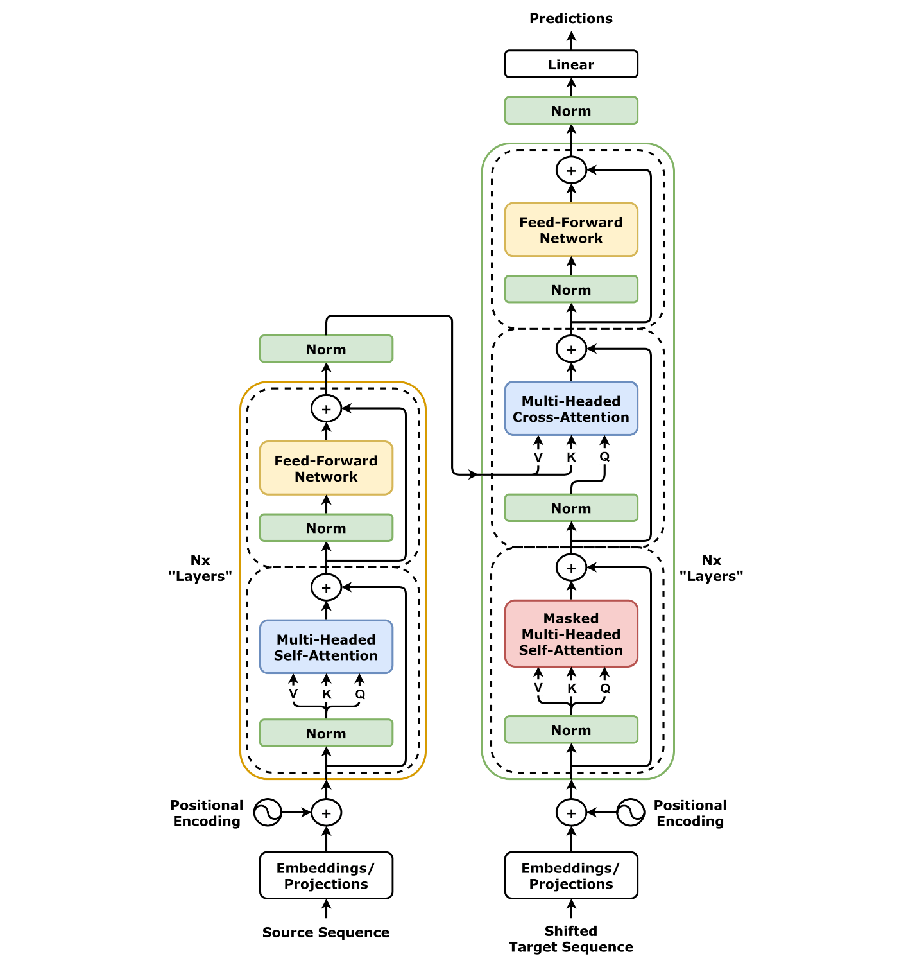
Key Ideas
Symmetries in nature can be modeling precisely using bespoke neural networks
Many of the most common types of AI algorithms (e.g., Transformers) are symmetric
Modeling real-world data with geometric deep learning has yielded compelling results

Slide 5
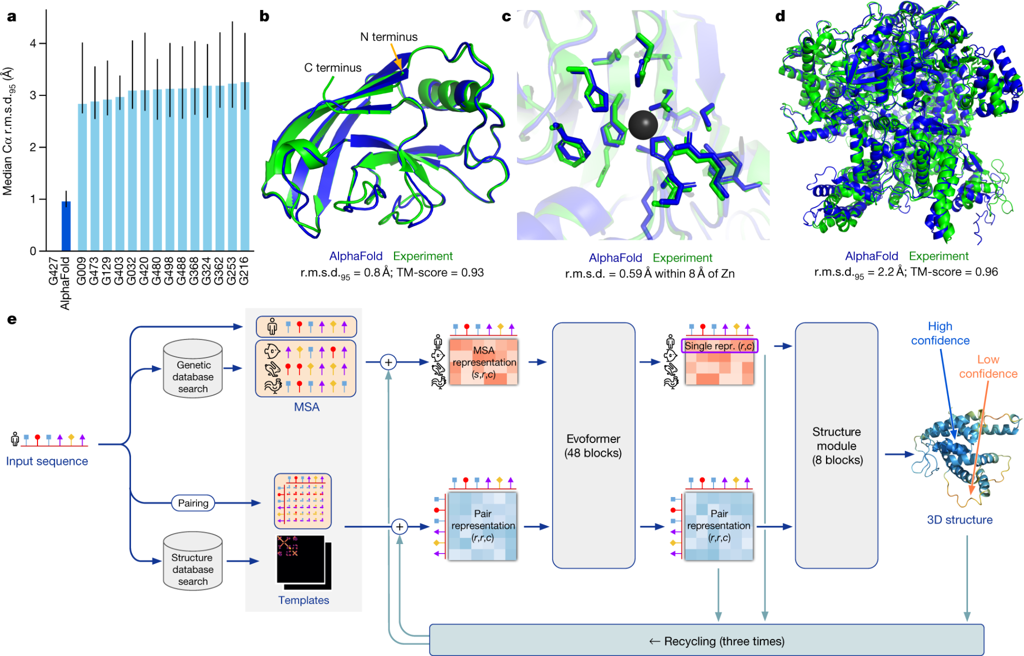
Geometric Deep Learning Case Study
(AlphaFold 2)
A prime example of AI4Science!
Reference: Jumper et al. 2021, Nature

Slide 6
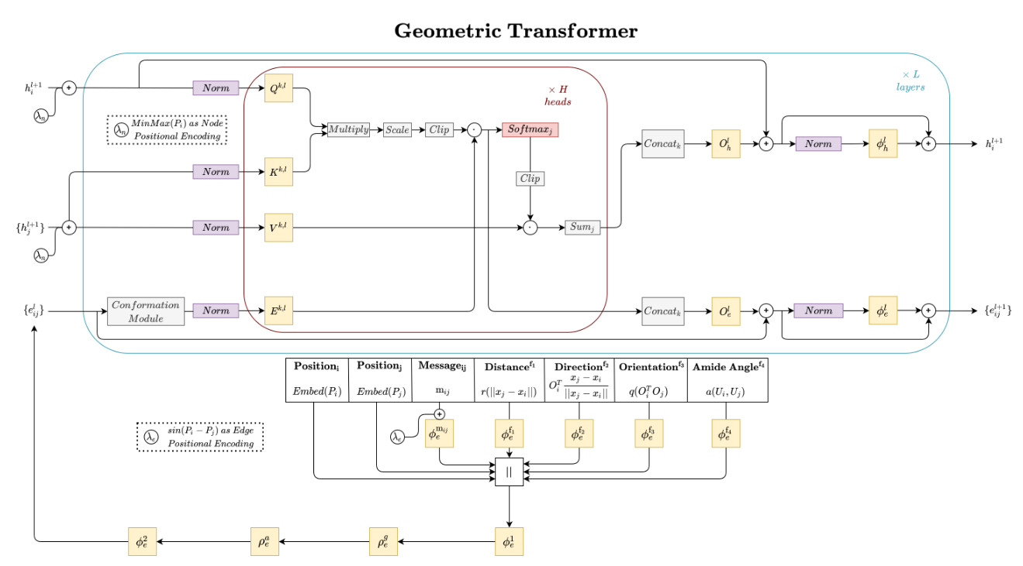
Geometric Deep Learning Case Study
(Geometric Transformer)
Deep graph learning for biomolecules
Reference: Morehead et al. 2022, ICLR

Slide 7
Geometric Deep Learning Case Study
(Geometric Transformer - Conformation Module)
The model uniquely learns representations of geometric line graphs for downstream predictions!
Reference: Morehead et al. 2022, ICLR

Slide 8
Geometric Deep Learning Case Study
(Geometric Transformer)
Geometric priors consistently improve predictions of atomic protein-protein interactions!
Reference: Morehead et al. 2022, ICLR
EPE: Edge Position Encoding; GFG: Geometric Feature Gating

Slide 9
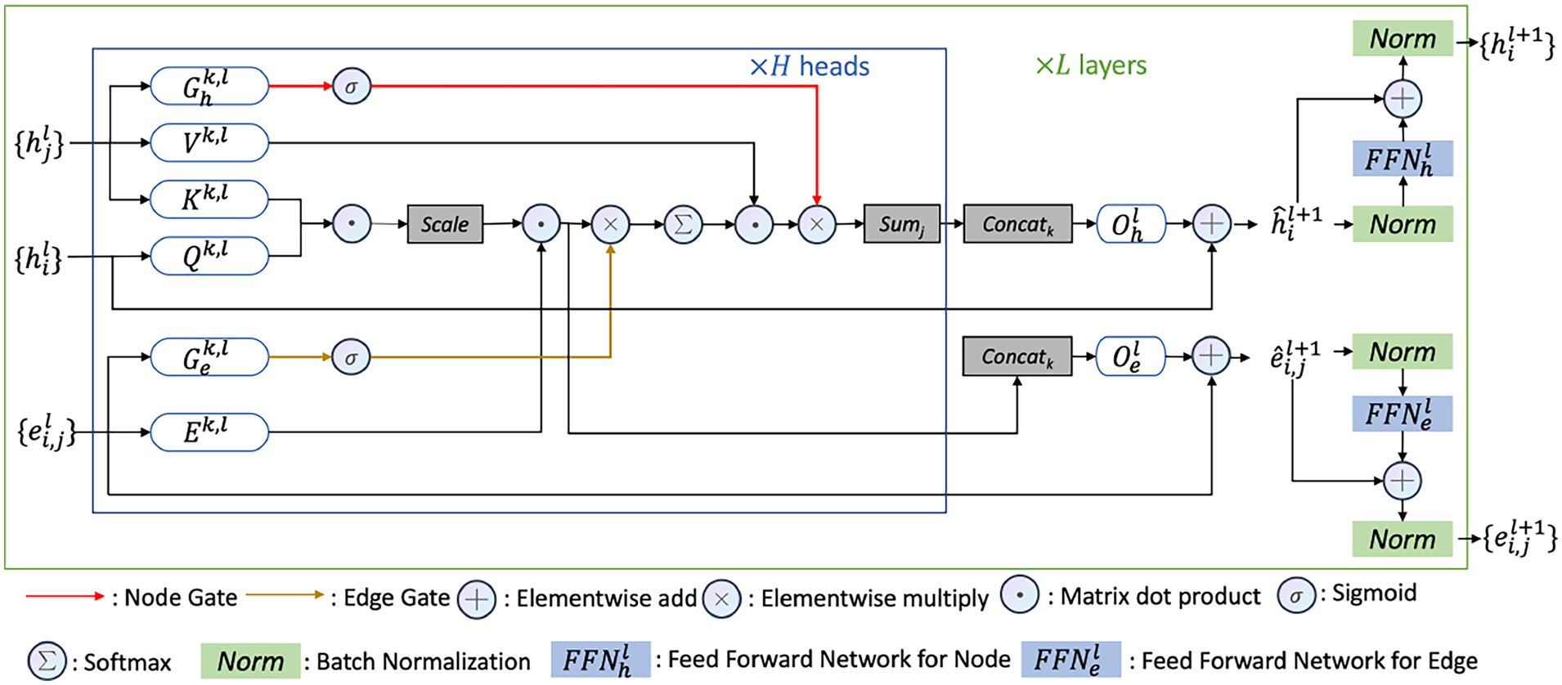
Geometric Deep Learning Case Study
(Gated Graph Transformer)
Learnable gating also played an important role in follow-up work on (multi-chain) protein representation learning
Reference: Chen*, Morehead*, et al. 2023, ISMB
*equal contribution
h: Node-Level Features; e: Edge-Level Features

Slide 10
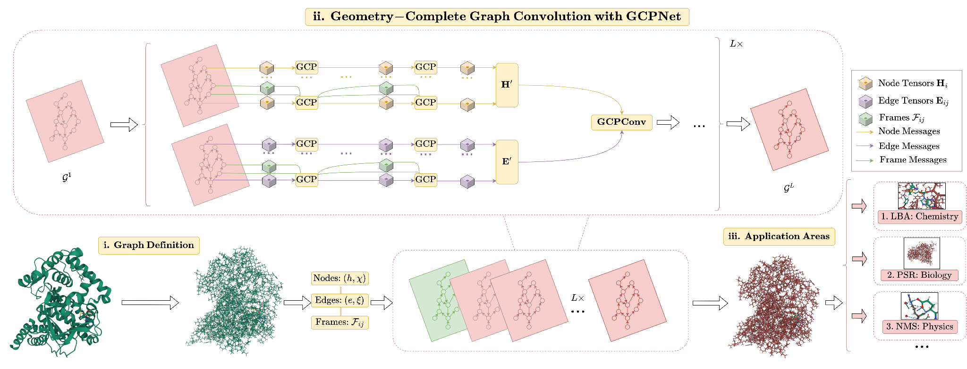
Geometric Deep Learning Case Study
(GCPNet)
A broadly applicable geometric graph neural network
Reference: Morehead et al. 2024, Bioinformatics

Slide 11
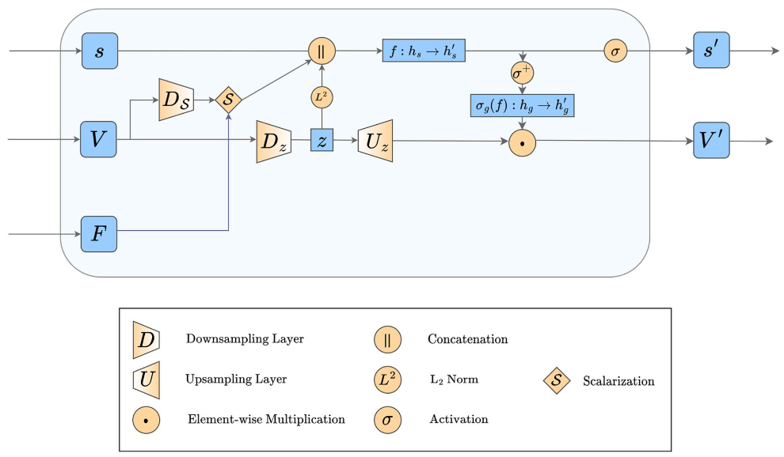
Geometric Deep Learning Case Study
(GCPNet - GCP Module)
Physical priors come from scalarization!
Reference: Morehead et al. 2024, Bioinformatics

Slide 12
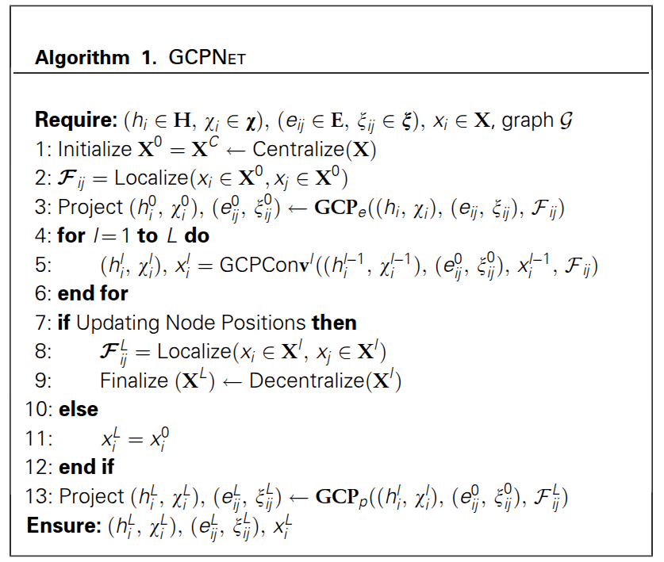
Geometric Deep Learning Case Study
(GCPNet - Forward Pass)
So how does this model work?
Reference: Morehead et al. 2024, Bioinformatics

Slide 13
Geometric Deep Learning Case Study
(GCPNet)
Physical priors are necessary for geometric neural networks to understand molecular chirality!
Reference: Morehead et al. 2024, Bioinformatics
Frames: Local Coordinate Frames; R/S: Right/Left

Slide 14
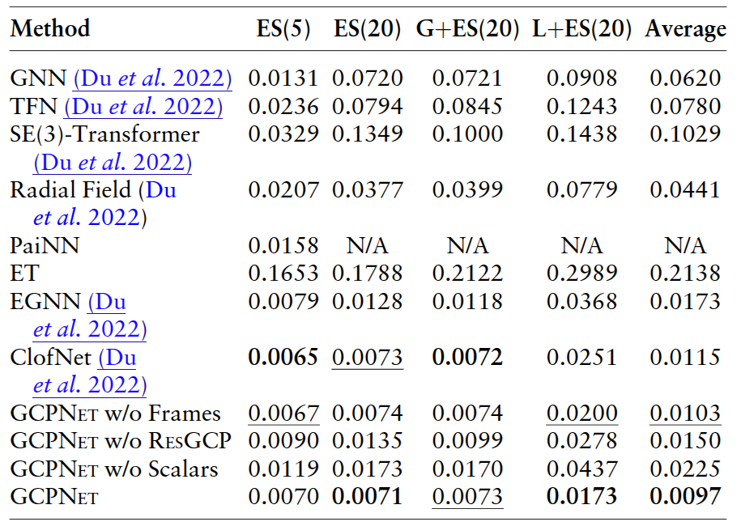
Geometric Deep Learning Case Study
(GCPNet)
For complex physical (many-body) systems, learnable geometric frames enable more precise point predictions
Reference: Morehead et al. 2024, Bioinformatics
Frames: Local Coordinate Frames; R/S: Right/Left

Slide 15
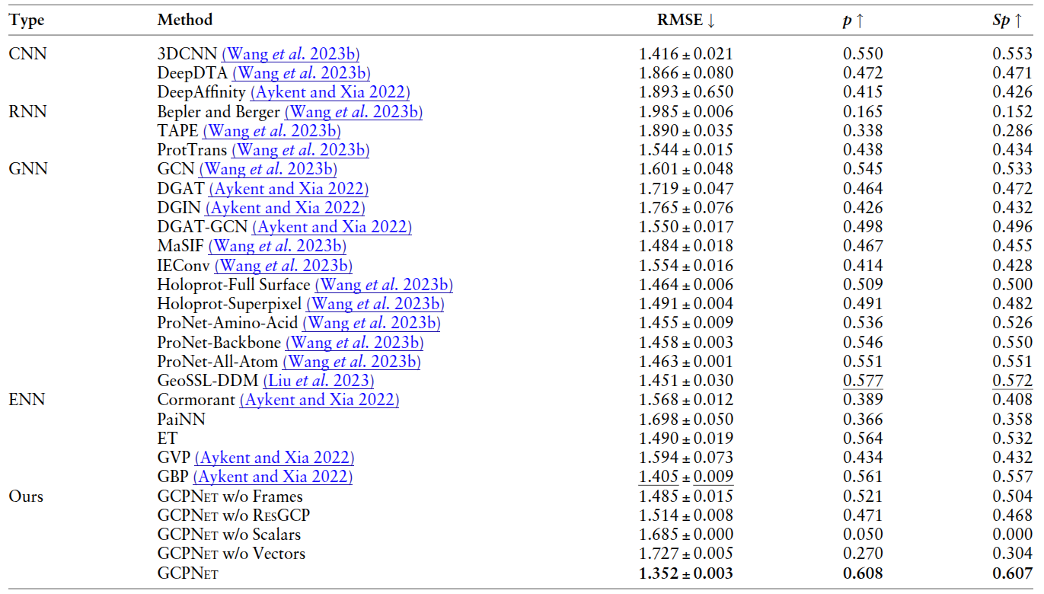
Geometric Deep Learning Case Study
(GCPNet)
Each model component is important for accurately predicting protein-ligand binding affinities
Reference: Morehead et al. 2024, Bioinformatics
Frames: Local Coordinate Frames; ResGCP: ResidualGCP

Slide 16
Geometric Deep Learning Case Study
(ProteinWorkshop)
GCPNet yielded excellent performance for inverse folding and protein-protein interaction prediction in a new standardized deep learning benchmark for protein representation learning
Reference: Jamasb*, Morehead*, et al. 2024, ICLR
*equal contribution

Slide 17
Geometric Deep Learning Case Study
(GCPNet-EMA)
GCPNet has since also been adapted as a state-of-the-art estimator of the model accuracy (EMA) of predicted protein structures
Reference: Morehead et al. 2024, Protein Science

Slide 18
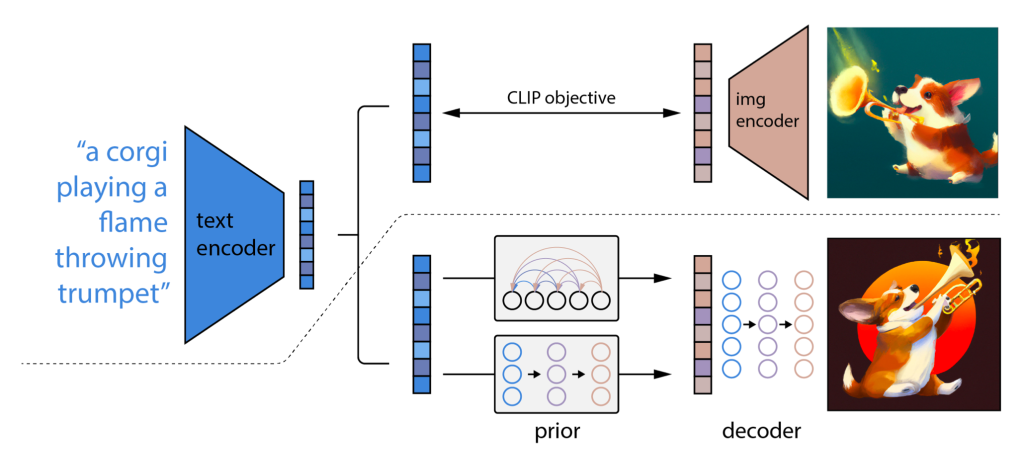
What about Generative Modeling?
Reference: Ramesh et al. 2022, arXiv

Slide 19
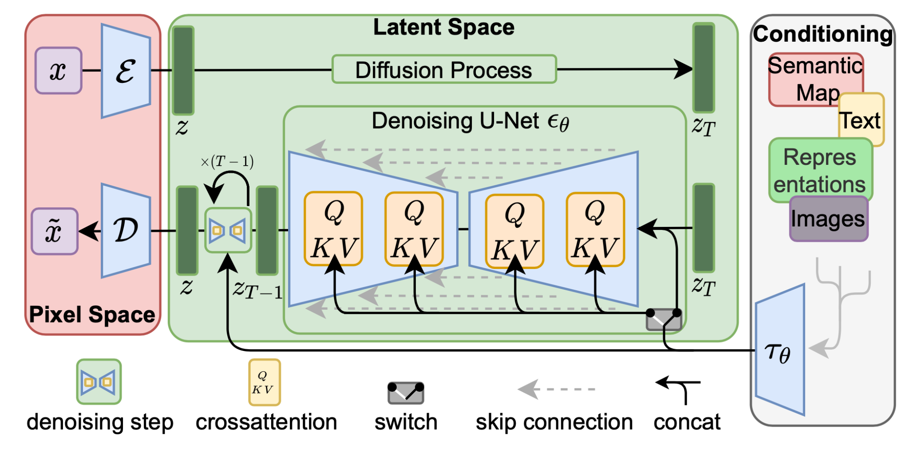
Key Ideas
Most datasets can become the basis of a powerful generative model of that domain
Once trained, such a generative model can generate new (similar yet distinct) examples
Importantly, these algorithms can enable complex data analysis within scientific pipelines
Reference: Rombach et al. 2022, CVPR

Slide 20
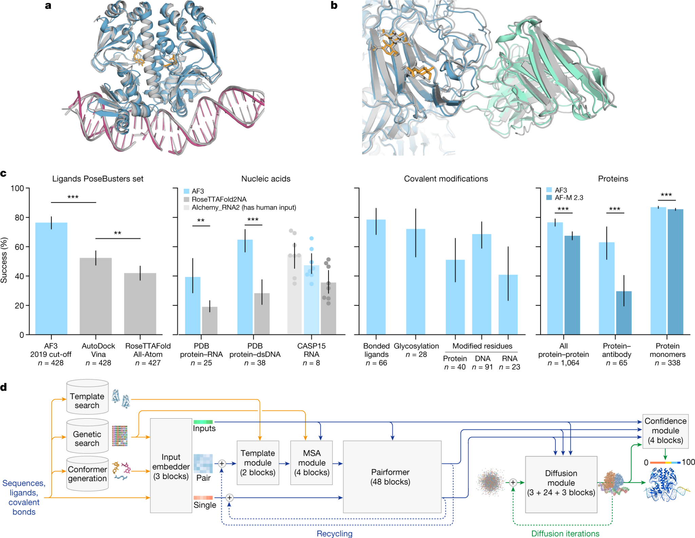
Generative Modeling Case Study
(AlphaFold 3)
Representing all of life’s molecules with denoising diffusion
Reference: Abramson et al. 2024, Nature

Slide 21
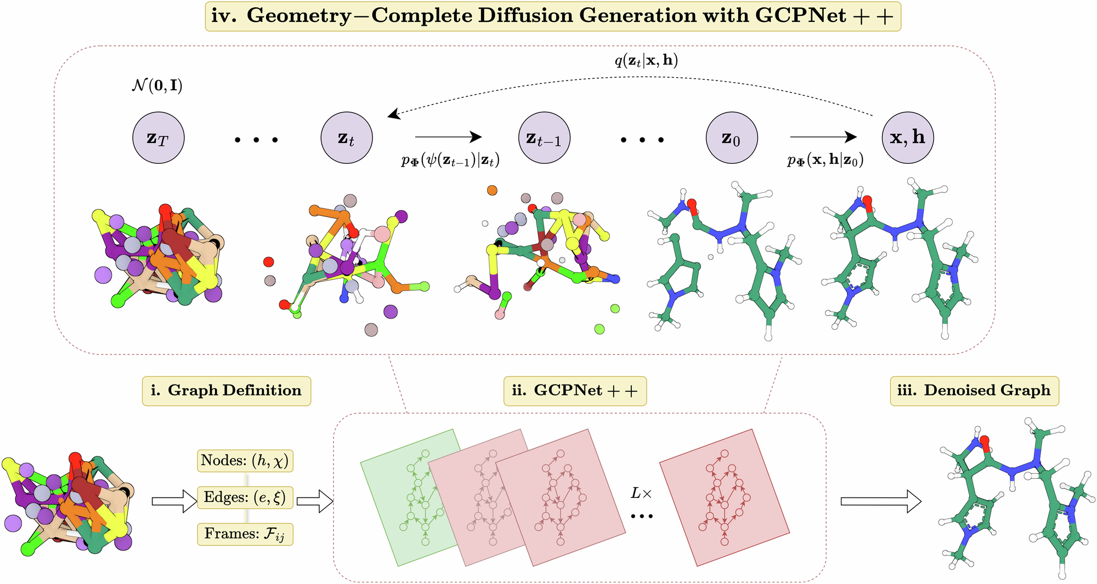
Generative Modeling Case Study
(GCDM)
Learning geometric (vector) features for diffusion generation
Reference: Morehead et al. 2024, Nature CommsChem

Slide 22
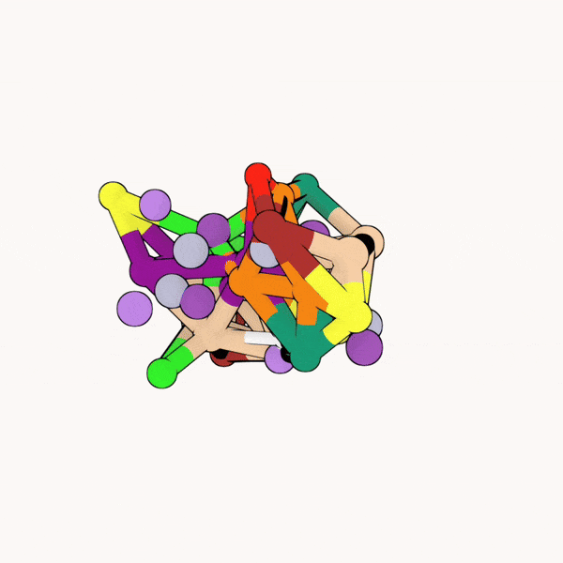
Generative Modeling Case Study
(GCDM)
Neural network expressiveness enables more precise 3D molecule generation for property conditioning
Reference: Morehead et al. 2024, Nature CommsChem

Slide 23
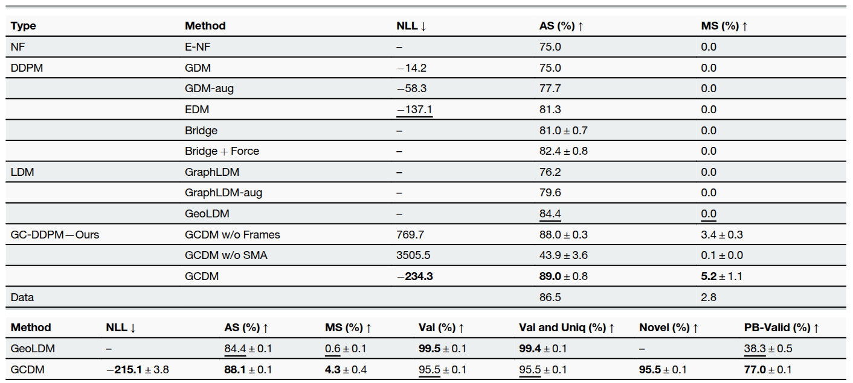
Generative Modeling Case Study
(GCDM)
Neural network expressiveness for the first enables diffusion models to generate a sizeable fraction of valid large 3D molecules!
Reference: Morehead et al. 2024, Nature CommsChem

Slide 24
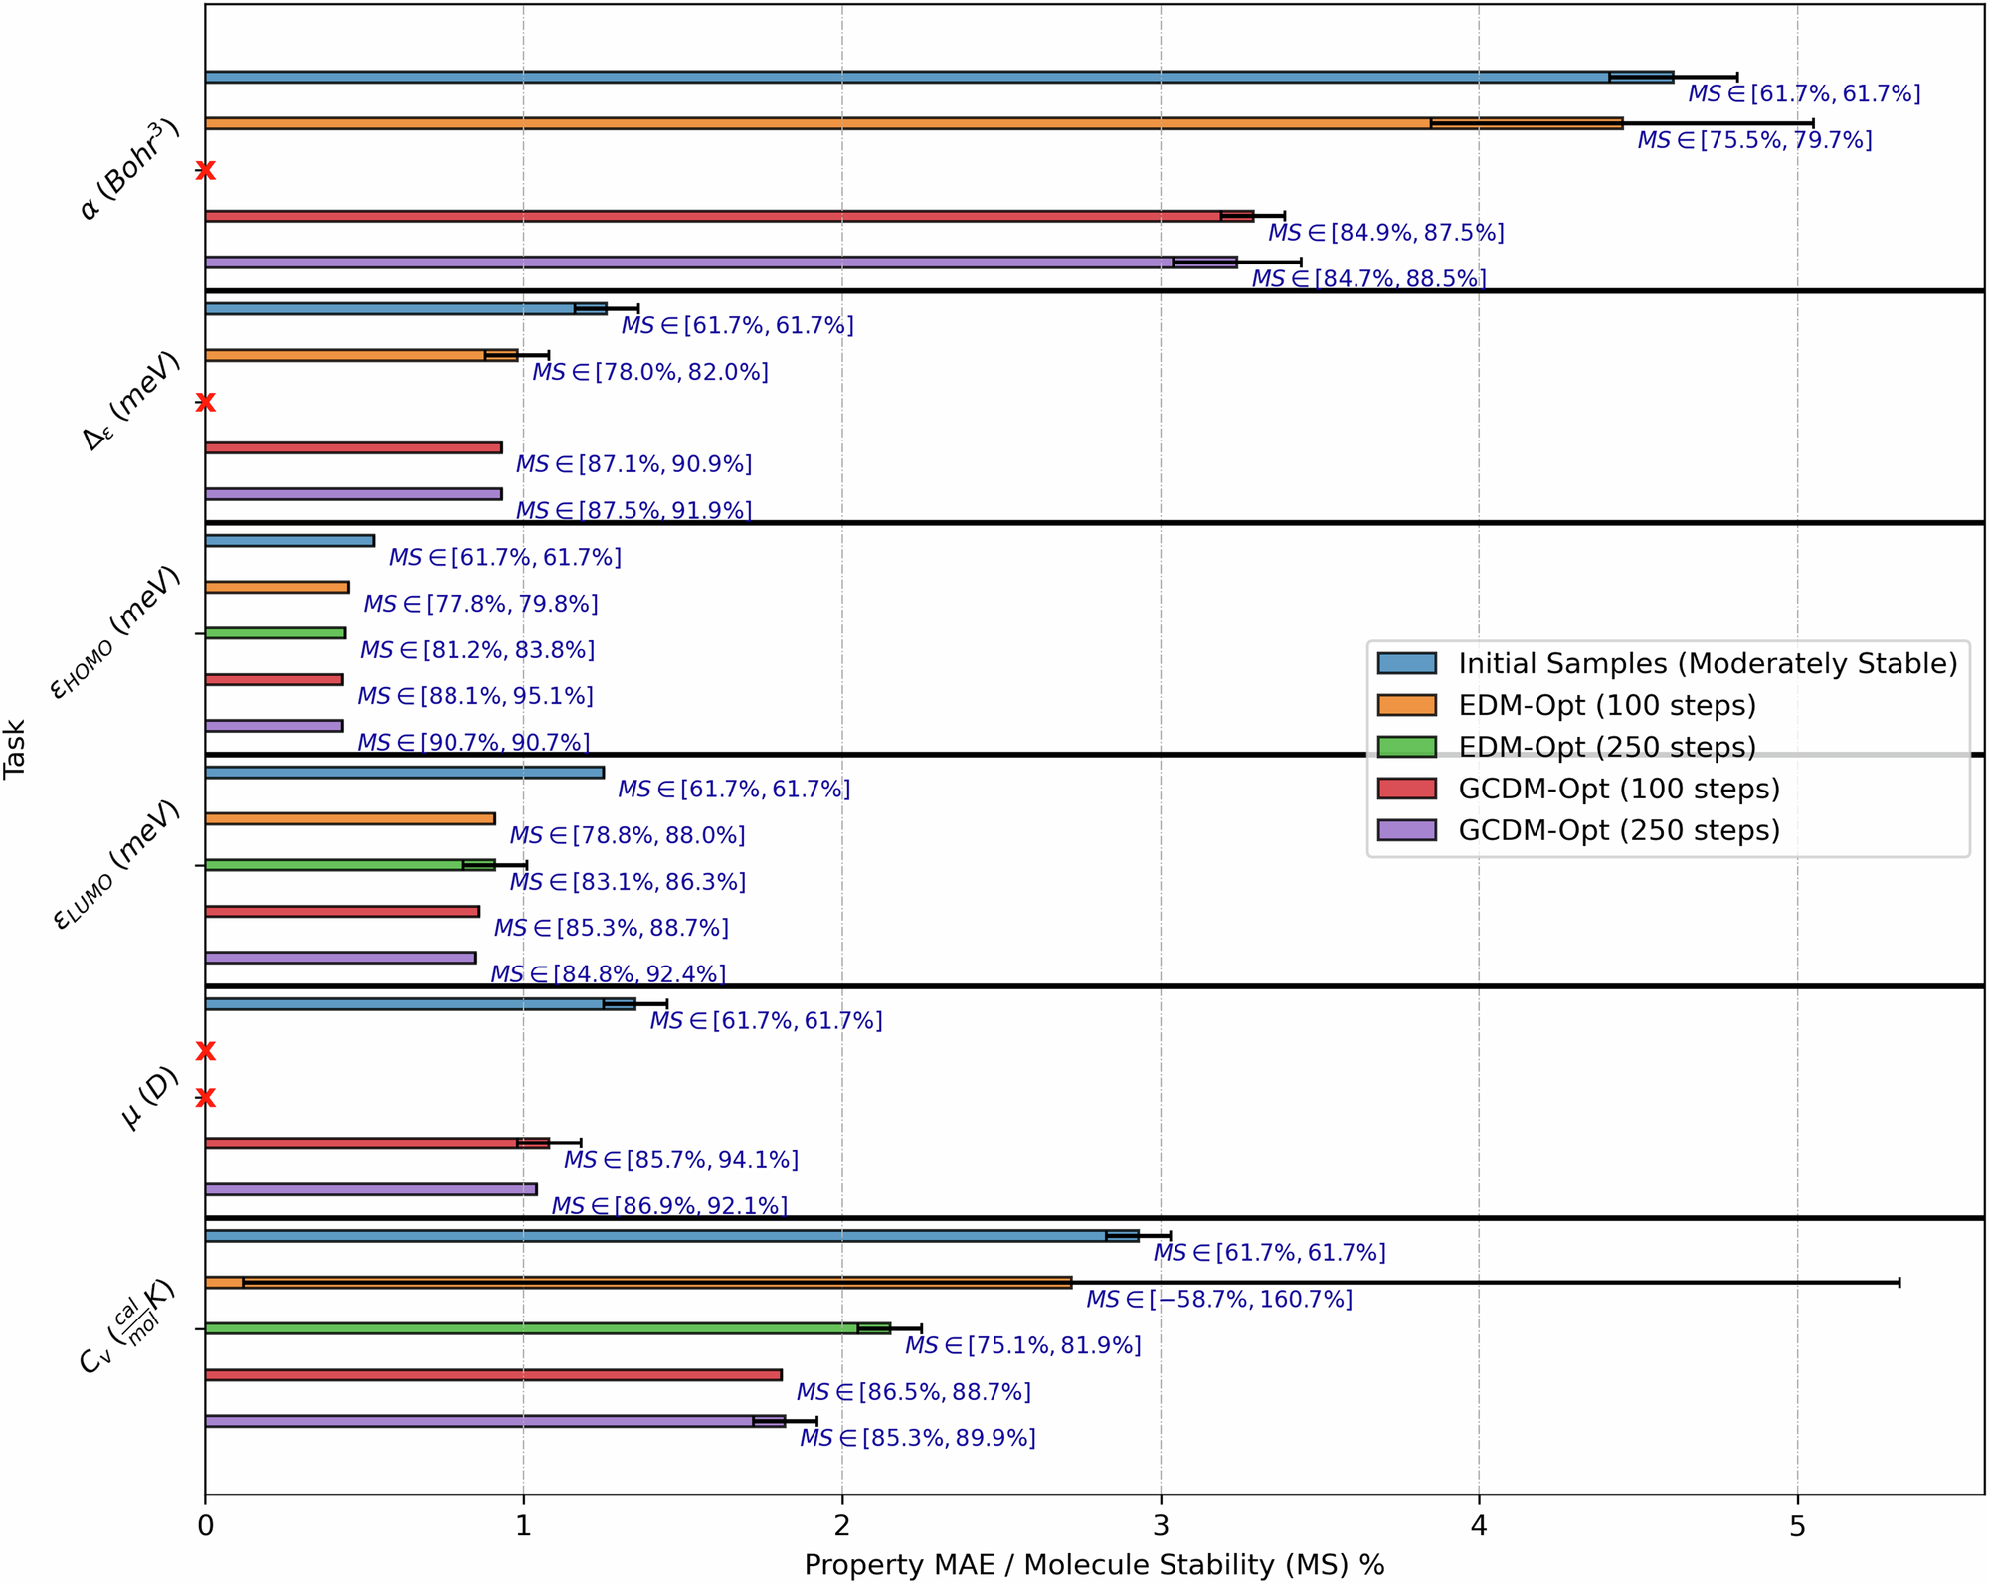
Generative Modeling Case Study
(GCDM)
Neural network expressiveness also yields consistent improvements in 3D molecule optimization of molecular properties
Reference: Morehead et al. 2024, Nature CommsChem

Slide 25
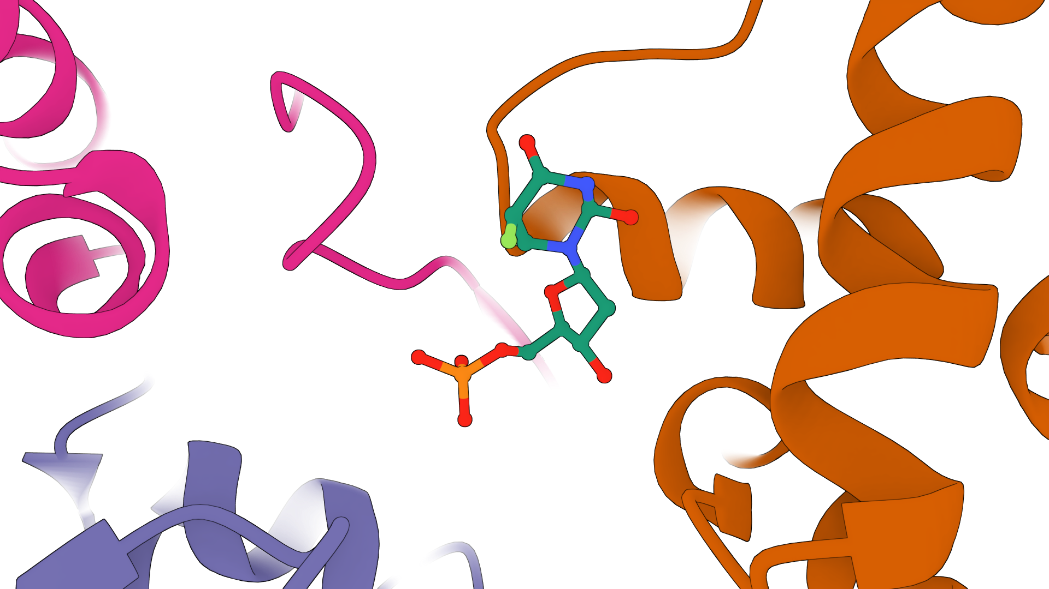
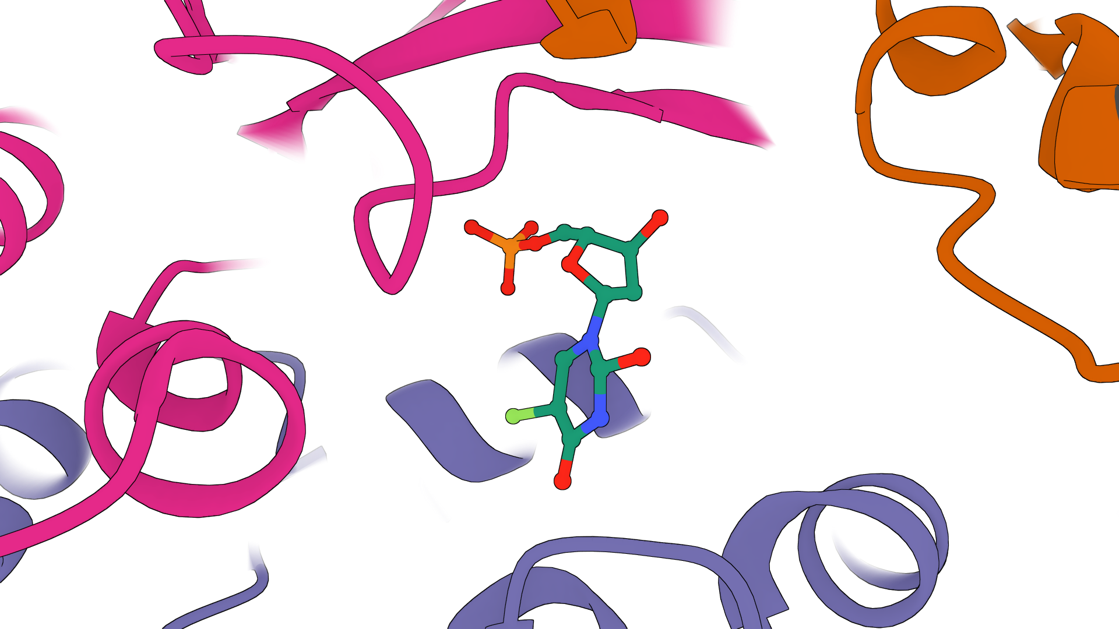
Generative Models Capture Molecular Details
DiffDock-L (Corso et al. 2024)
NeuralPLexer (Qiao et al. 2024)
In the past two years, deep generative models have demonstrated the ability to produce realistic protein-binding conformations of ligand molecules
References: Corso et al. 2024, ICLR; Qiao et al. 2024, NMI

Slide 26
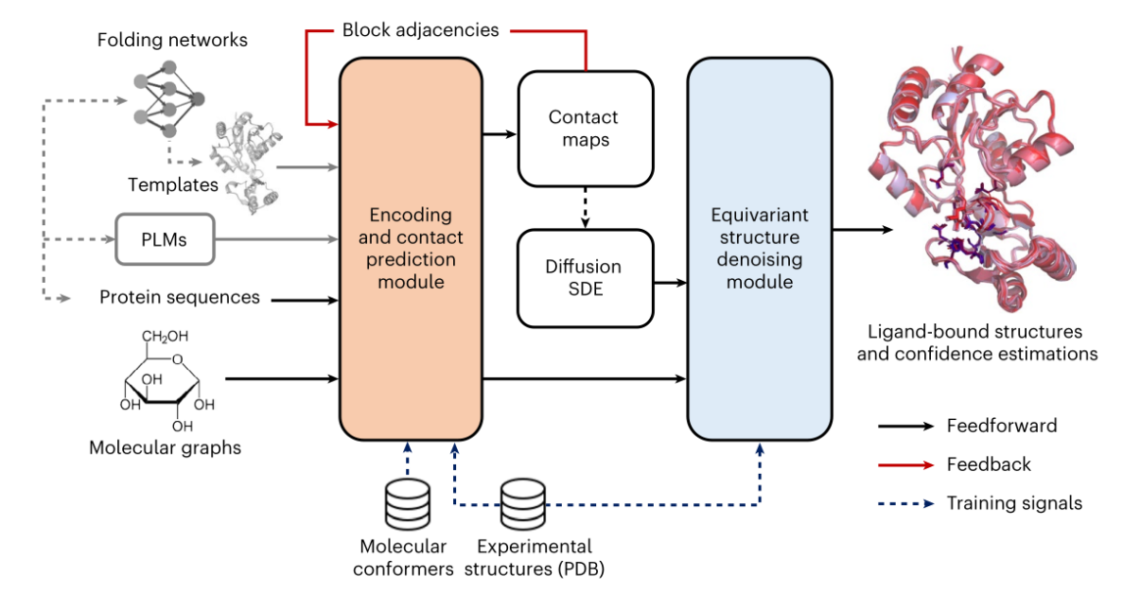
Do Generative Models Learn Meaningful Features?
NeuralPLexer (Qiao et al. 2024)
Key Insight: Generative structure prediction models, when pre-trained on large datasets of biomolecules, learn meaningful features that are readily adapted for binding affinity estimation
Reference: Qiao et al. 2024, NMI

Slide 27
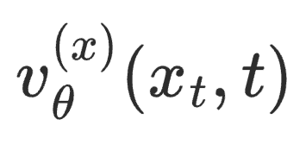
But What about Docking State Transitions?
→ Flow Matching in 3D
noise
target
We fine-tune NeuralPLexer as
our denoiser v_{θ}
The denoiser v_{θ} predicts
3D coordinate updates
x₁
x₀
3D Coordinates
t=0
t = 1
References: Chen et al. 2024, ICLR; Jing et al. 2024, ICML

Slide 28
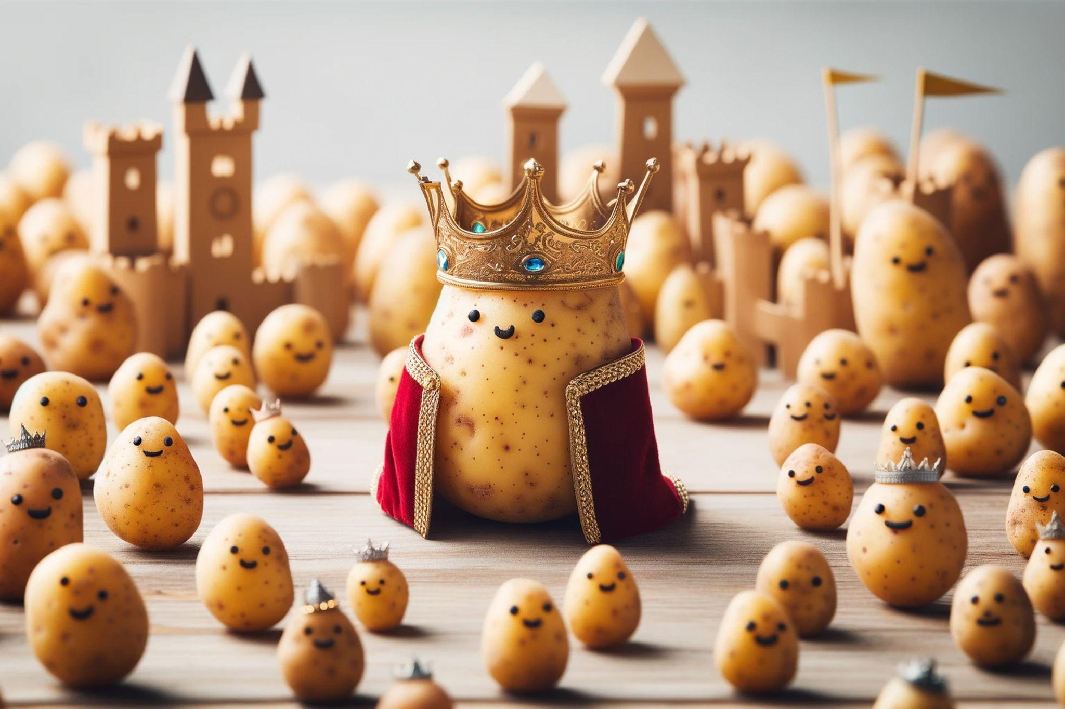
Another Angle on Flow Matching
Gaussian flow matching → a kingdom of potatoes?
References: Fjelde et al. 2024, Blog Post; Esser et al. 2024, ICML

Slide 29
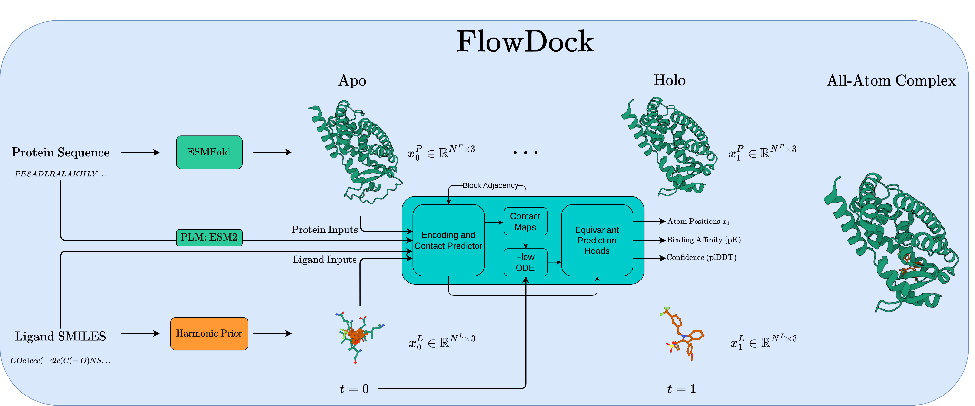
Generative Modeling Case Study
(FlowDock)
The first available deep learning (blind) docking method based on conditional flow matching
Reference: Morehead et al. 2025, ISMB

Slide 30
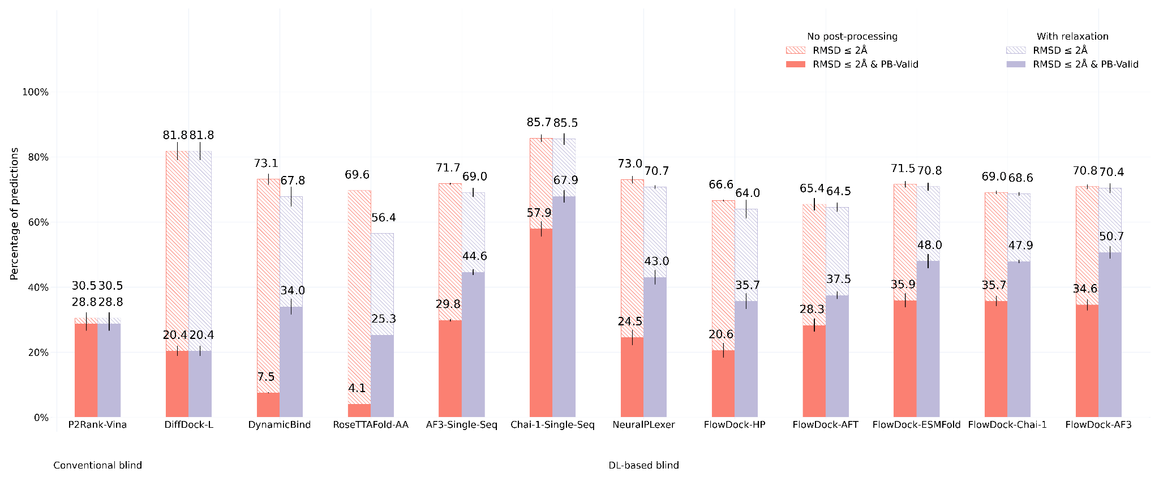
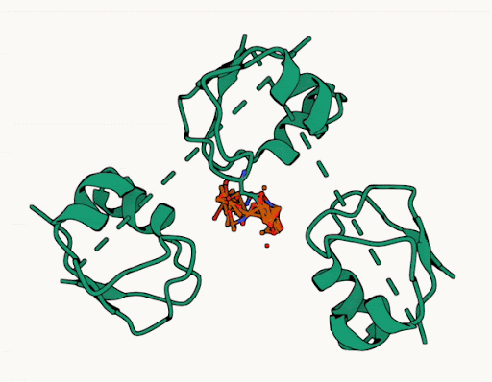
Generative Modeling Case Study
(FlowDock - PoseBusters)
FlowDock debuts as a lightweight and accurate generative model of biomolecular structures
Reference: Morehead et al. 2025, ISMB

Slide 31
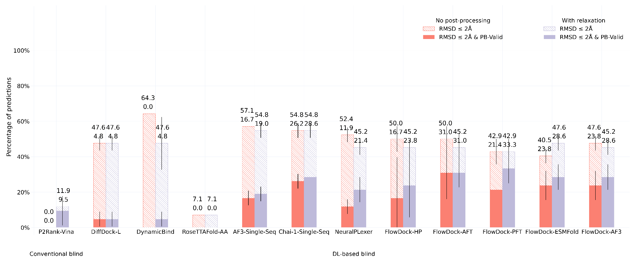
Generative Modeling Case Study
(FlowDock - DockGen)
FlowDock matches or exceeds the generalization capabilities of previous state-of-the-art methods
Reference: Morehead et al. 2025, ISMB

Slide 32
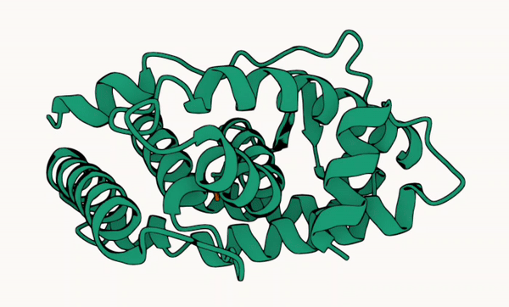
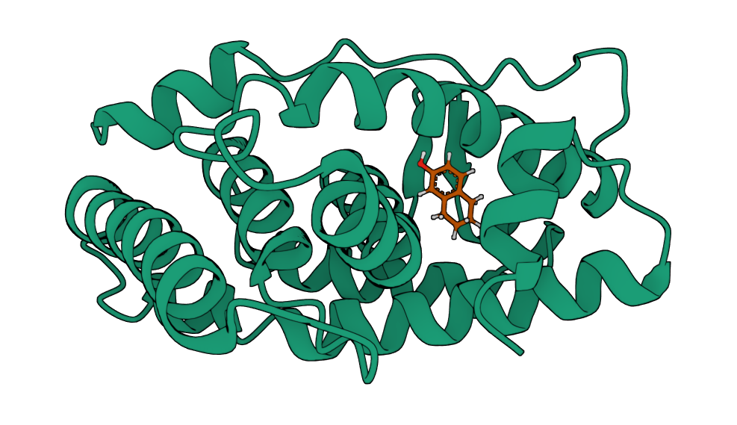
Accurate Sampling Trajectories
Generated Structure of PDBBind 6I67
(Predicted Affinity: 6.05)
Crystal Structure of PDBBind 6I67
(True Affinity 6.70)
Flow matching enables flexible docking via deep learning
Reference: Morehead et al. 2025, ISMB

Slide 33
Generative Modeling Case Study
(FlowDock - PDBBind)
This (fast) model can accurately predict both biomolecular structures and binding affinities!
Reference: Morehead et al. 2025, ISMB

Slide 34
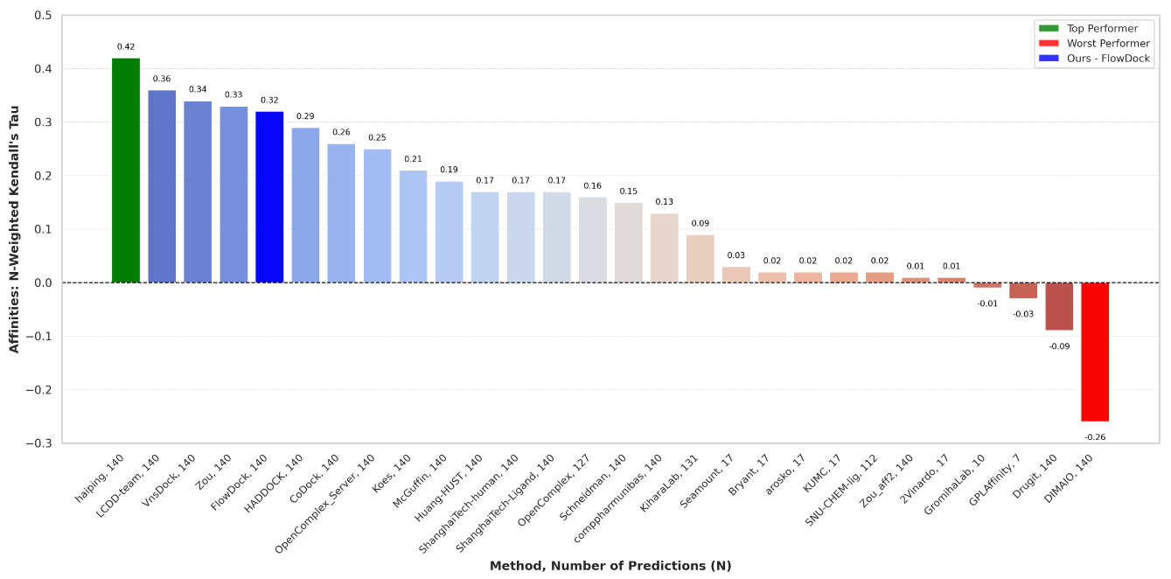
Generative Modeling Case Study
(FlowDock - CASP16)
Selected for an oral presentation at CASP16!
Reference: Morehead et al. 2025, ISMB

Slide 35
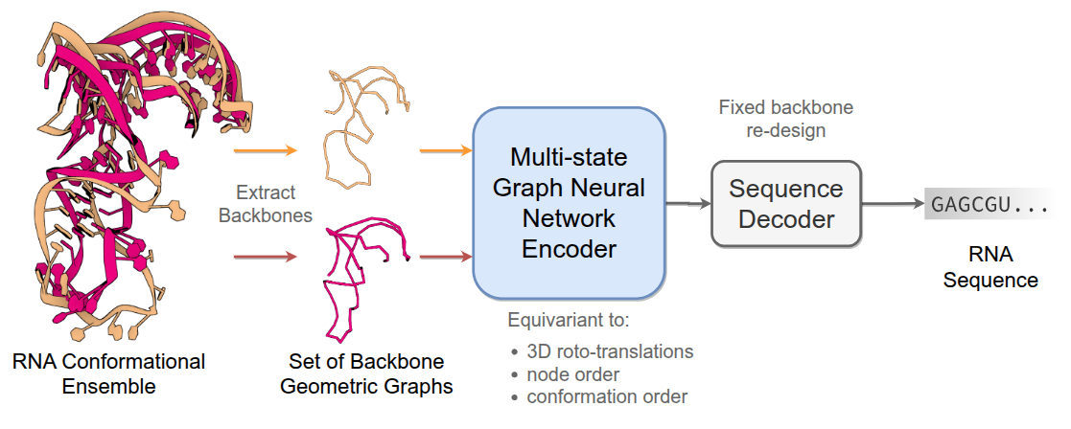
How does this impact Biomolecule Design?
Reference: Joshi et al. 2025, ICLR

Slide 36
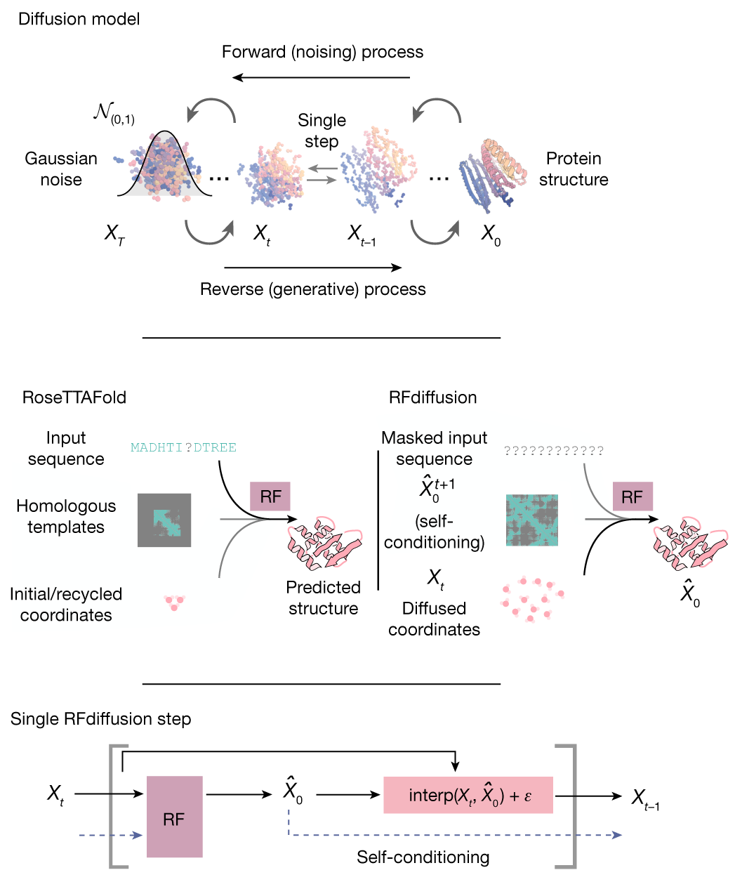
Key Ideas
As geometric and generative models become more powerful, the number of promising biomolecule design use cases grows
Nonetheless, data quality (1) and quantity (2) can be rate limiters of successful design efforts
Pre-training on large (related) datasets can be a useful way to initialize a generative design model
Reference: Watson et al. 2023, Nature

Slide 37
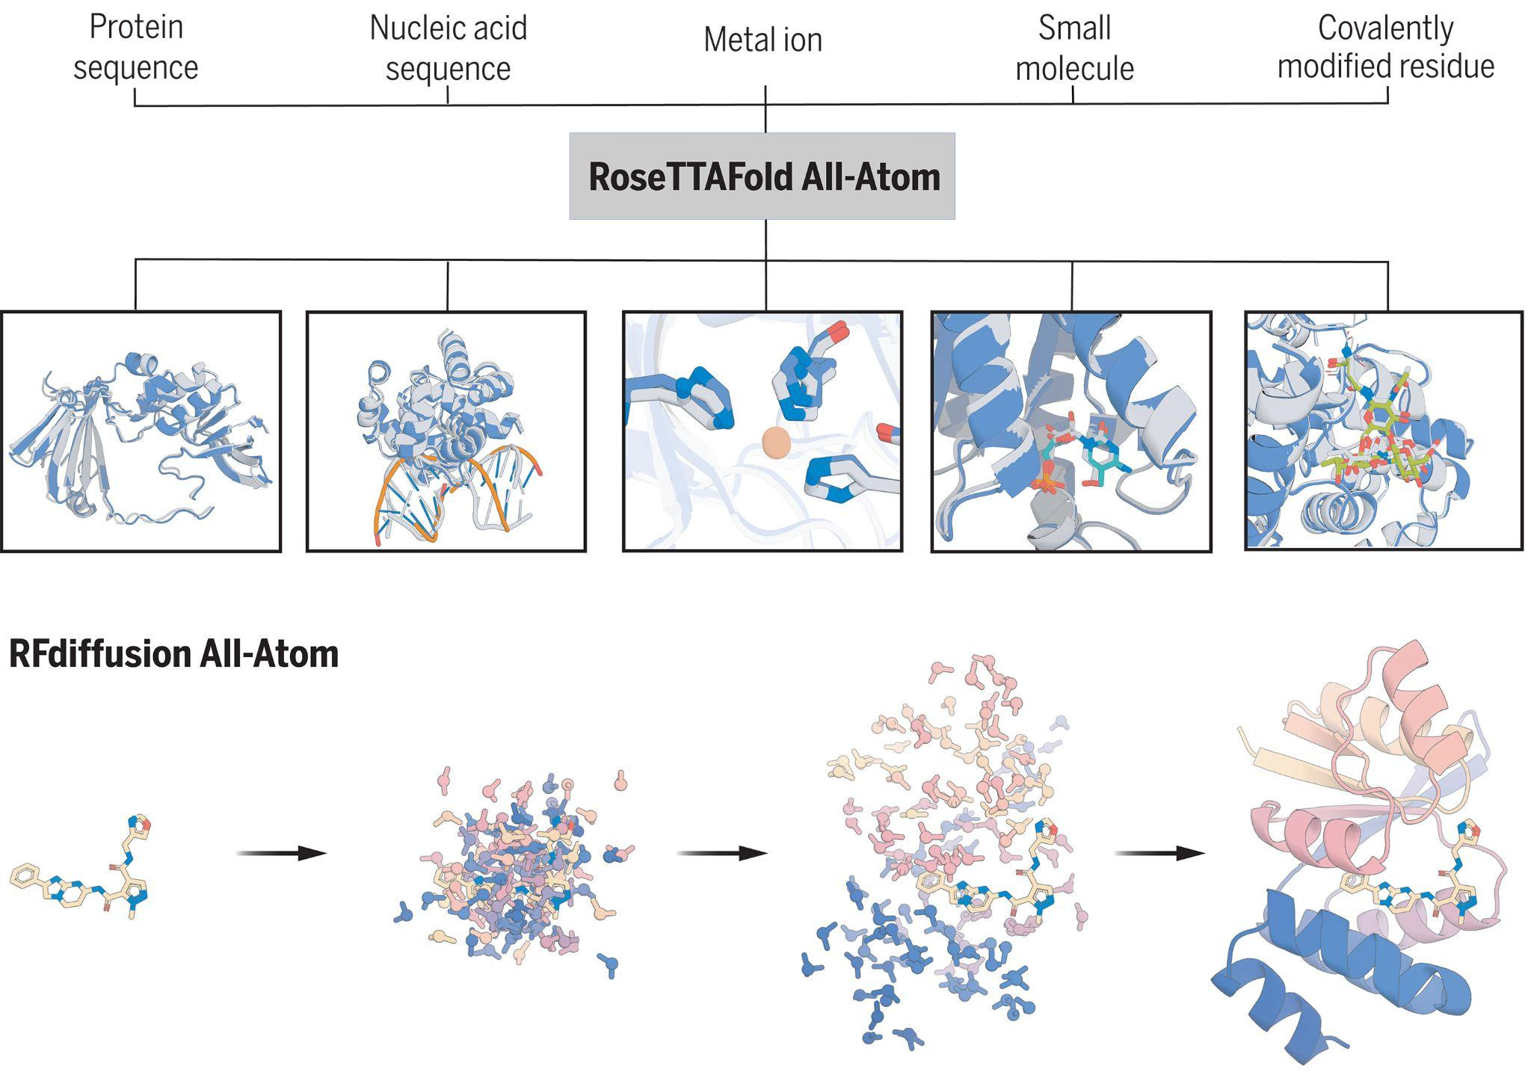
Biomolecule Design Case Study
(RoseTTAFoldAA & RFdiffusionAA)
Atomic biomolecule design is here!
Reference: Krishna et al. 2024, Science

Slide 38
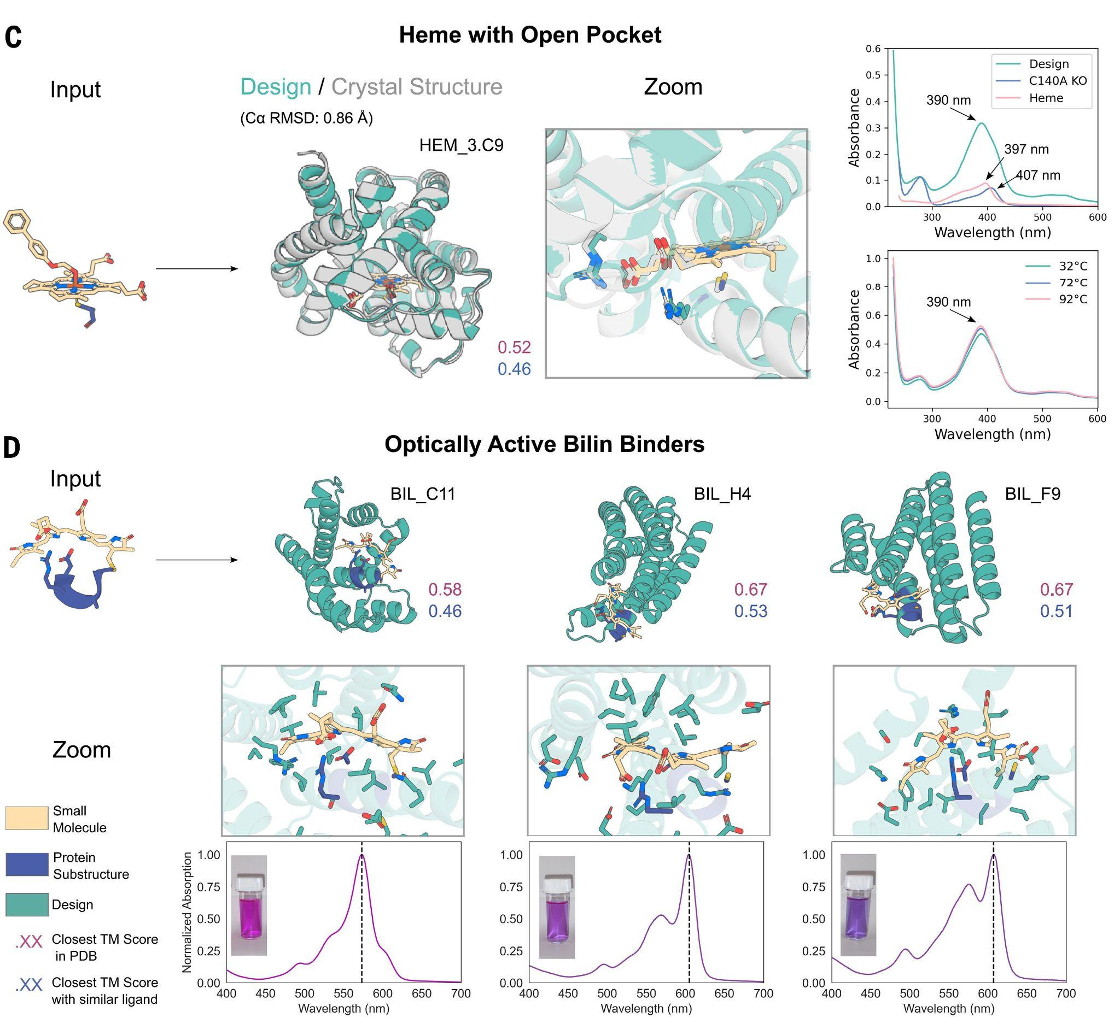
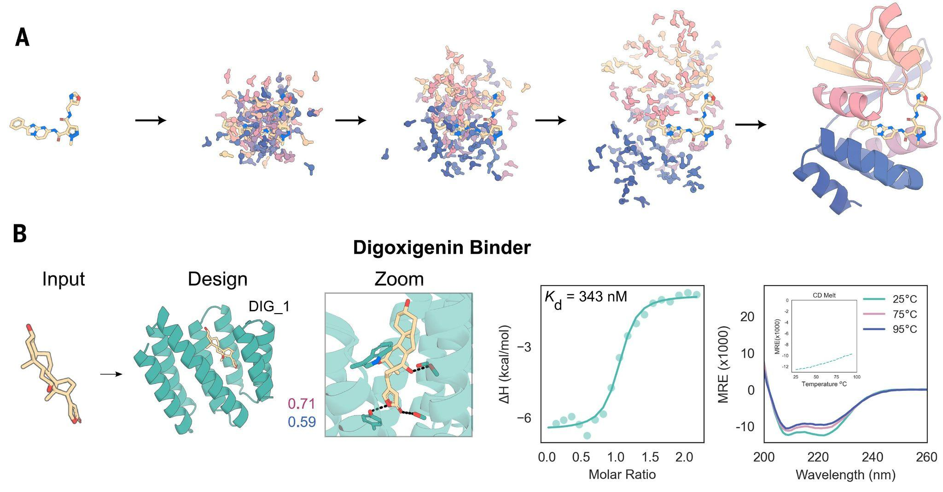
Biomolecule Design Case Study
(RoseTTAFoldAA & RFdiffusionAA)
Experimentally characterizing proteins designed for specific small molecules
Reference: Krishna et al. 2024, Science

Slide 39
Biomolecule Design Case Study
(GCDM-SBDD)
Finding: Molecule generation models can readily be repurposed as structure-based drug designers
Reference: Morehead et al. 2024, Nature CommsChem

Slide 40
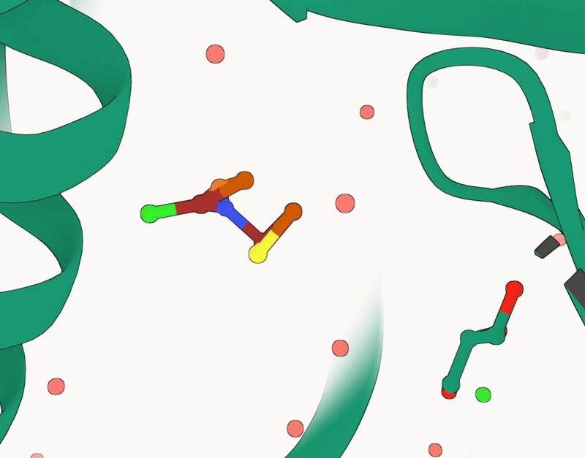
Biomolecule Design Case Study
(GCDM-SBDD)
Note: Most structure-based drug design methods based on generative modeling are primarily challenged with pocket design specificity
Reference: Morehead et al. 2024, Nature CommsChem

Slide 41
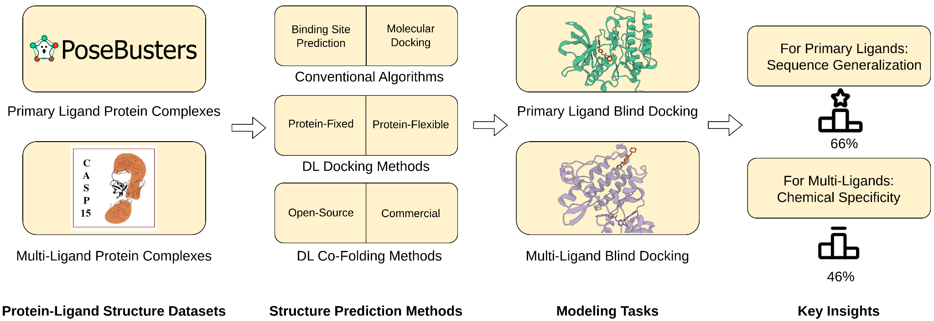
Biomolecule Design Case Study
(PoseBench)
Intuition: An algorithm must be an accurate structure predictor before design is tractable
Reference: Morehead et al. 2024, ICML AI4Science (Spotlight)

Slide 42
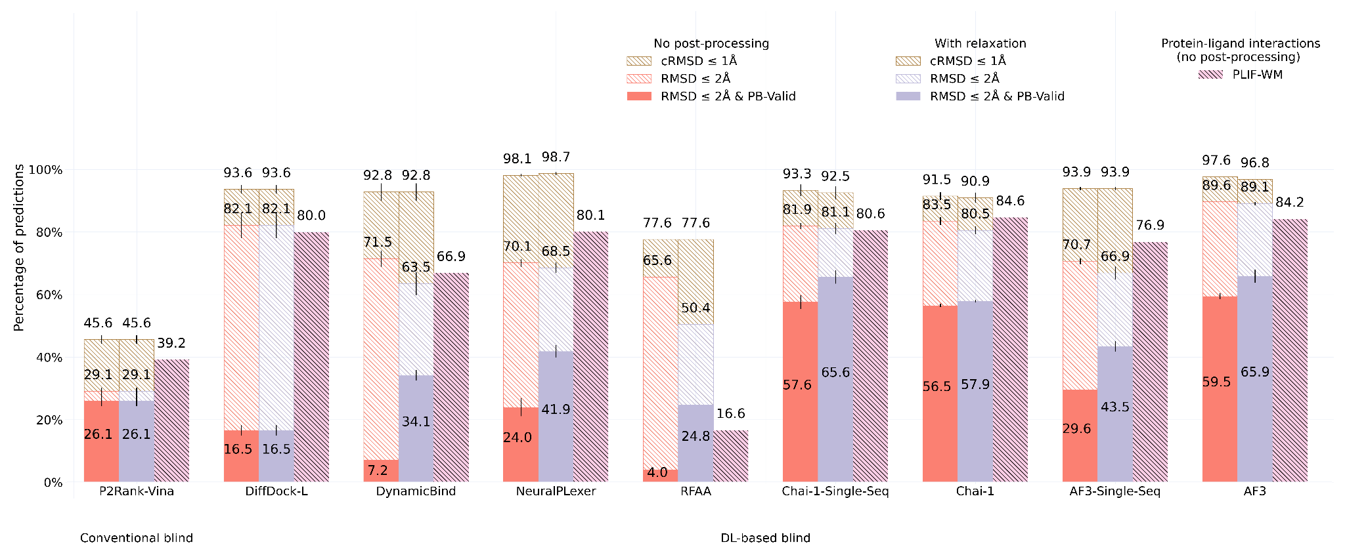
Biomolecule Design Case Study
(PoseBench - PoseBusters Benchmark)
Benchmarking results: AlphaFold 3 is currently the best structure predictor around, but not by a lot (and only with high-quality multiple sequence alignment inputs)
Reference: Morehead et al. 2024, ICML AI4Science (Spotlight)

Slide 43
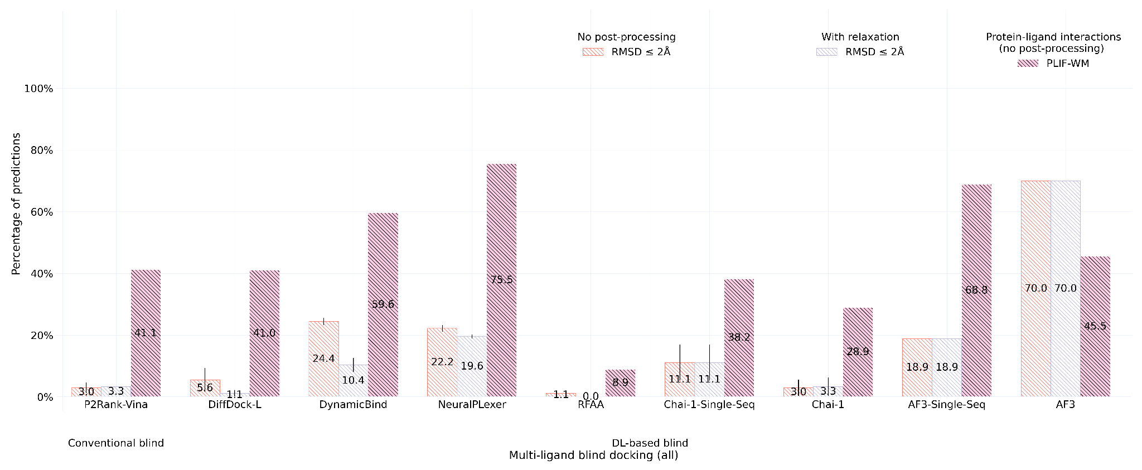
Biomolecule Design Case Study
(PoseBench - CASP16 Benchmark)
Benchmarking results: In diverse (multi-molecule) use cases, AlphaFold 3 shines, yet it is still challenged to faithfully model crystalized protein-ligand interactions
Reference: Morehead et al. 2024, ICML AI4Science (Spotlight)

Slide 44
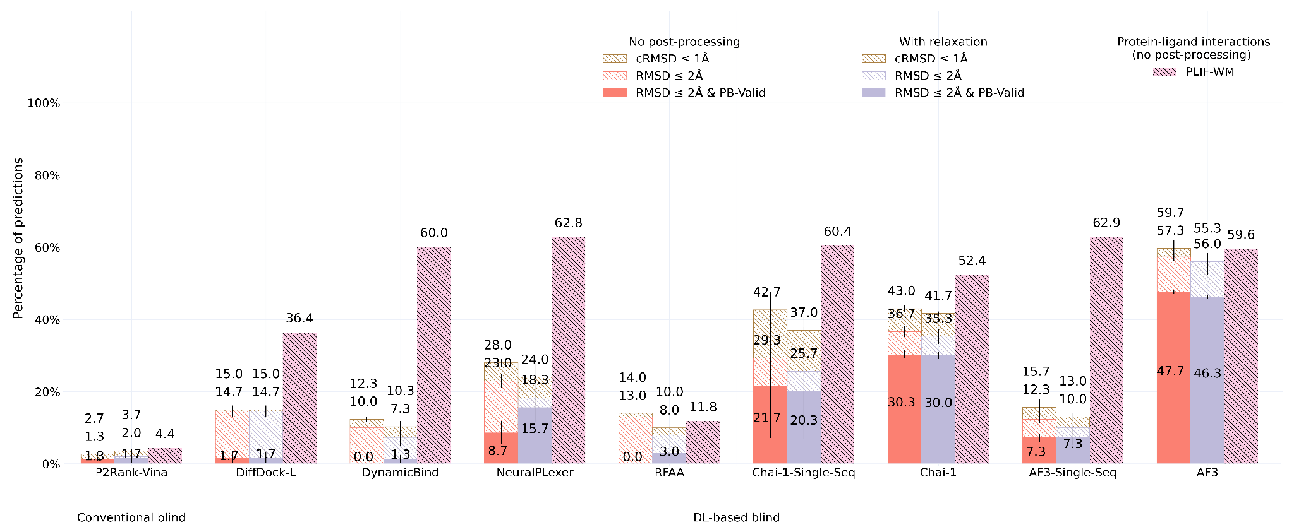
Biomolecule Design Case Study
(PoseBench - DockGen-E Benchmark)
Benchmarking results: Even for datasets overlapping with AlphaFold 3’s training data, uncommon prediction targets highlight the model’s room for improvement
Reference: Morehead et al. 2024, ICML AI4Science (Spotlight)

Slide 45
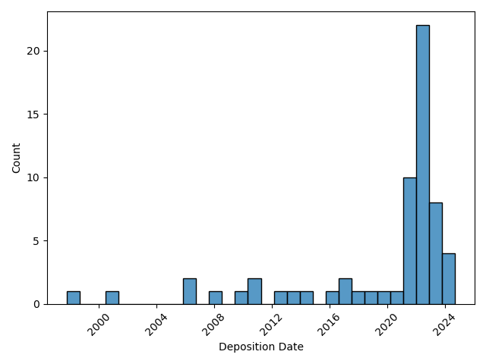
Biomolecule Design Case Study
(PoseBench - Failure Modes Analysis)
Analysis: Most of the time when AlphaFold 3 makes an inaccurate prediction, the prediction target is evolutionarily distinct from what the model has seen
Reference: Morehead et al. 2024, ICML AI4Science (Spotlight)

Slide 46
Biomolecule Design Case Study
(PoseBench - Common Failure Modes)
Analysis: Even the best structure prediction methods such as AlphaFold 3 have trouble predicting several important classes of proteins
Reference: Morehead et al. 2024, ICML AI4Science (Spotlight)

Slide 47
Biomolecule Design Case Study
(MULTICOM_ligand)
Finding: An unsupervised best-of-N deep learning ensemble performs remarkably well compared to specialist (singular) prediction algorithms
Reference: Morehead et al. 2025, Proteins (CASP16-Invited Issue)

Slide 48
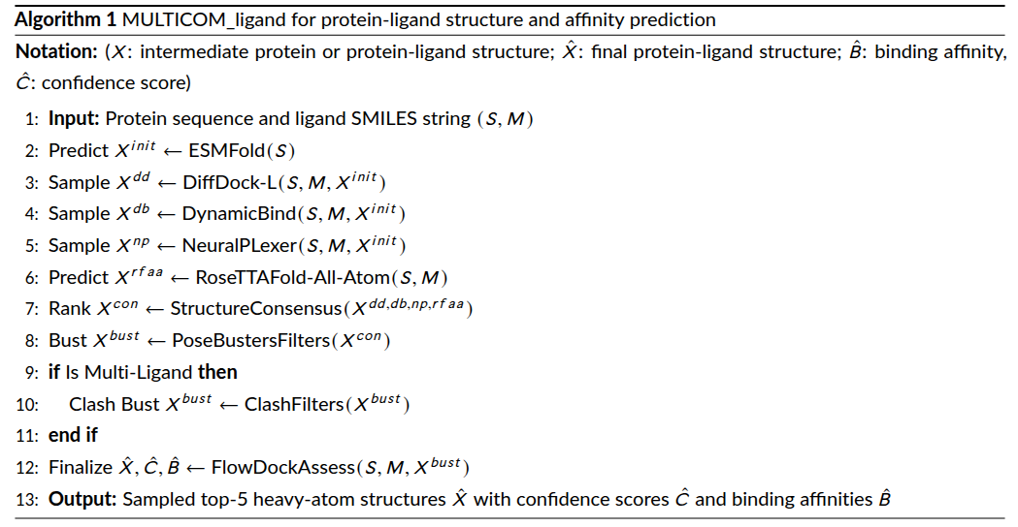
Biomolecule Design Case Study
(MULTICOM_ligand)
Overview: How does this ensemble work?
Reference: Morehead et al. 2025, Proteins (CASP16-Invited Issue)

Slide 49
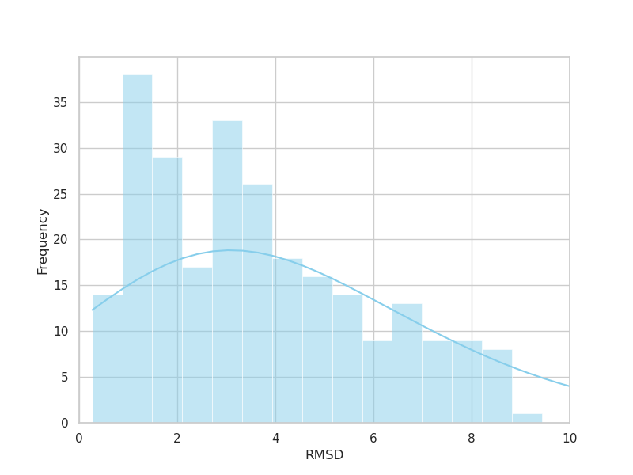
Biomolecule Design Case Study
(MULTICOM_ligand)
Evaluation: How well does this ensemble do in a (CASP16) blind assessment?
Reference: Morehead et al. 2025, Proteins (CASP16-Invited Issue)

Slide 50
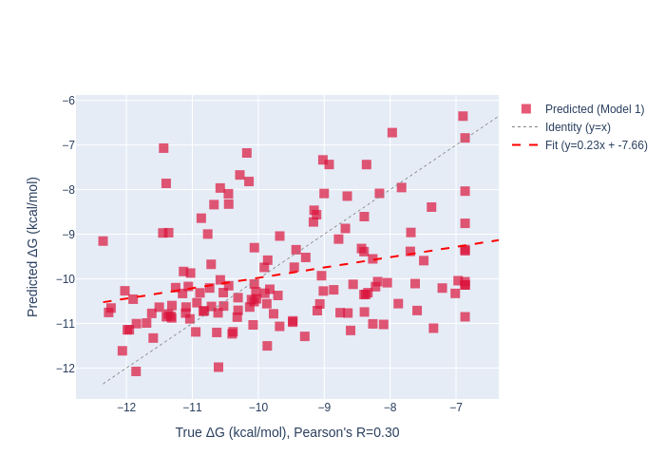
Biomolecule Design Case Study
(MULTICOM_ligand)
Capabilities: How well can this method predict binding affinities?
Reference: Morehead et al. 2025, Proteins (CASP16-Invited Issue)

Slide 51
Biomolecule Design Case Study
(MULTICOM_ligand)
Analysis: How do this method’s (best and worst) predictions look?
Reference: Morehead et al. 2025, Proteins (CASP16-Invited Issue)

Slide 52
Interdisciplinary Challenges
Developing proper benchmarks and evaluation metrics for deep learning-based structure prediction and design methods requires dual computing and life science expertise
Evaluating the performance of structure-based drug design methods is bottlenecked by the rate of wet lab experiments a group can complete
Whether, and the extent to which, deep learning methods for biochemical data can generalize to novel types of biomolecules are open questions for the field

Slide 53
Future Directions
Exploring the design space of biomolecular diffusion models could be a powerful new means of drug discovery
Neural network expressiveness could be more strongly characterized and linked to the (in)capabilities of today’s bio-generative models
Generative modeling is primed for innovation from the perspective of biophysical priors and conditional flow matching

Slide 54
Dissertation Outcomes (1)
This PhD dissertation has yielded 8 first-author publications (with 3 additional papers either currently in review or released as a preprint) and has contributed to 20+ peer-reviewed works overall (including one NIH grant proposal)
These first-author (+co-first-author) publications include 2 (+2) works presented at top CS conferences (according to CSRankings) including the International Conference on Learning Representations (ICLR) and Intelligent Systems for Molecular Biology (ISMB) and 2 works published in Nature Portfolio journals

Slide 55
Dissertation Outcomes (2)
To date, this dissertation’s associated papers have garnered 450+ citations and inspired multiple follow-up works in machine learning (GearNet - ICLR 2023 2023) and generative modeling (RNA-FrameFlow - ICML 2024 SPIGM)
Further, this dissertation has been awarded the Berkeley Lab’s 2025 Admiral Grace Hopper Postdoctoral Fellowship in Computing Sciences

Slide 56
References (1)
Gao, Mu, et al. "High-performance deep learning toolbox for genome-scale prediction of protein structure and function." 2021 IEEE/ACM Workshop on Machine Learning in High Performance Computing Environments (MLHPC). IEEE, 2021.
Morehead, Alex, Chen Chen, and Jianlin Cheng. "Geometric Transformers for Protein Interface Contact Prediction." International Conference on Learning Representations (ICLR 2022).
Morehead, Alex, et al. "EGR: Equivariant graph refinement and assessment of 3D protein complex structures." arXiv preprint arXiv:2205.10390 (2022).
Shoman, Maged, et al. "A region-based deep learning approach to automated retail checkout." Proceedings of the IEEE/CVF Conference on Computer Vision and Pattern Recognition. 2022.
Lensink, Marc F., et al. "Impact of AlphaFold on structure prediction of protein complexes: The CASP15‐CAPRI experiment." Proteins: Structure, Function, and Bioinformatics 91.12 (2023): 1658-1683.
Chen*, Xiao, Morehead*, Alex, et al. "A gated graph transformer for protein complex structure quality assessment and its performance in CASP15." Bioinformatics 39.Supplement_1 (ISMB 2023): i308-i317.
Morehead, Alex, et al. "Towards Joint Sequence-Structure Generation of Nucleic Acid and Protein Complexes with SE (3)-Discrete Diffusion." NeurIPS Machine Learning in Structural Biology (MLSB) Workshop, 2023.
Morehead, Alex, et al. "DIPS-Plus: The enhanced database of interacting protein structures for interface prediction." Scientific Data 10.1 (2023): 509.

Slide 57
References (2)
Morehead*, Alex, Watchanan Chantapakul*, and Jianlin Cheng. "Semi-supervised graph learning meets dimensionality reduction." 2023 International Conference on Machine Learning and Applications (ICMLA). IEEE, 2023.
Chen, Chen, et al. "3D-equivariant graph neural networks for protein model quality assessment." Bioinformatics 39.1 (2023): btad030.
Mahmud, Sajid, Alex Morehead, and Jianlin Cheng. "Accurate prediction of protein tertiary structural changes induced by single-site mutations with equivariant graph neural networks." bioRxiv (2023): 2023-10.
Soltanikazemi, Elham, et al. "DRLComplex: Reconstruction of protein quaternary structures using deep reinforcement learning." International Conference on Intelligent Biology and Medicine (2023).
Shanehsazzadeh, Amir, et al. "Unlocking de novo antibody design with generative artificial intelligence." BioRxiv (2023): 2023-01.
Morehead, Alex, and Jianlin Cheng. "Geometry-complete perceptron networks for 3D molecular graphs." Bioinformatics 40.2 (2024): btae087.
Morehead, Alex, and Jianlin Cheng. "Geometry-complete diffusion for 3D molecule generation and optimization." Communications Chemistry 7.1 (2024): 150.
Morehead, Alex, Jian Liu, and Jianlin Cheng. "Protein structure accuracy estimation using geometry‐complete perceptron networks." Protein Science 33.3 (2024): e4932.

Slide 58
References (3)
Jamasb*, A. R., Morehead*, A., et al. "Evaluating Representation Learning on the Protein Structure Universe." International Conference on Learning Representations (ICLR 2024).
Morehead, Alex, et al. "Deep Learning for Protein-Ligand Docking: Are We There Yet?." ICML 2024 AI for Science Workshop Spotlight.
Anand*, Rishabh, Joshi*, Chaitanya, Morehead, Alex, et al. "RNA-FrameFlow for de novo 3D RNA backbone design." ICML 2024 Workshop on Structured Probabilistic Inference & Generative Modeling (ICML 2024 SPIGM).
Joshi, Chaitanya K., et al. "gRNAde: Geometric Deep Learning for 3D RNA inverse design." International Conference on Learning Representations (ICLR 2025).
Morehead, Alex, and Jianlin Cheng. "FlowDock: Geometric Flow Matching for Generative Protein-Ligand Docking and Affinity Prediction." Bioinformatics 39.Supplement_1 (ISMB 2025): i308-i317.
Morehead, Alex, et al. "Protein-ligand structure and affinity prediction in CASP16 using a geometric deep learning ensemble and flow matching." Proteins: Structure, Function, and Bioinformatics (2025).
Morehead*, Alex, Jian Liu*, Pawan Neupane*, and Jianlin Cheng. “Artificial intelligence for biomolecular structure and interaction prediction: recent advances and challenges.” In preparation for invited issue of Current Opinion in Structural Biology (2026).
* denotes co-first-authorship (equal contribution)

Slide 59
Summary
Thank you!
Geometric deep learning is a widely applicable toolkit for computational modeling of physical phenomena.
Geometric and generative models are accelerating biochemical science.
Large-scale deep learning efforts are poised to introduce new modalities for scientific inquiry within drug discovery and beyond.
Website
GitHub

